Slide 1
Client Query Management System

Slide 2
Agenda
01
Introduction
Features
02
Tech Stack
03

Slide 3
01
Introduction

Slide 4
Stream lit-based ticket management system
Clients submit queries
Support team manages and closes tickets
Admin monitors data with date filters and charts
PostgreSQL used as backend database

Slide 5
HOW IT WORKS
CLIENT
ADMIN
SUPPORT
Client logs in and submits a support query with issue details.
Admin reviews the query and assigns it to the support team with priority and SLA.
Support team works on the ticket, updates status, and closes the issue.

Slide 6
02
FEATURES

Slide 7
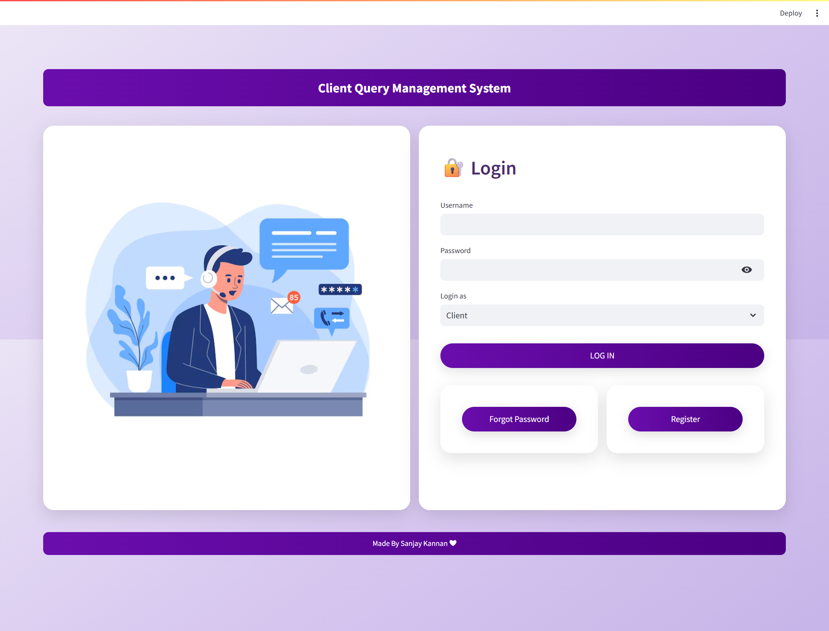
Login Page

Slide 8
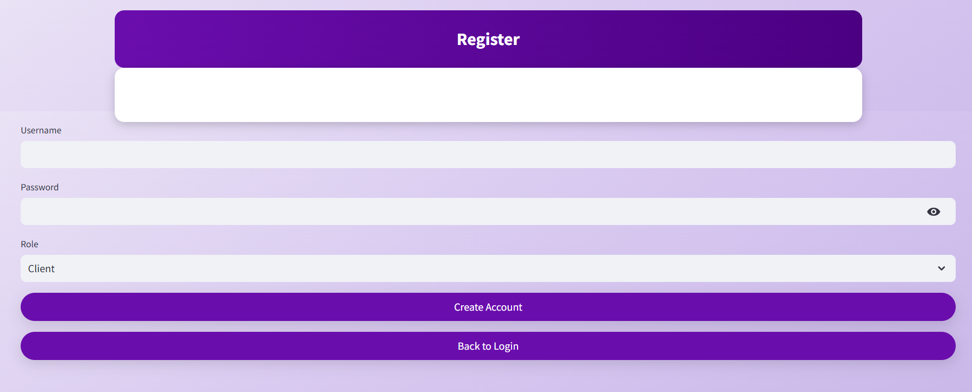
Register Page

Slide 9

Rest Password Page

Slide 10
Client query page
HELP!

Slide 11
PROBLEM
SOLUTION
!
?
?
!
!
?
I have submitted a support ticket regarding an issue
Hi! We’ve received your ticket and are working on it.
Thanks for the update
The issue has been resolved and the ticket is closed

Slide 12
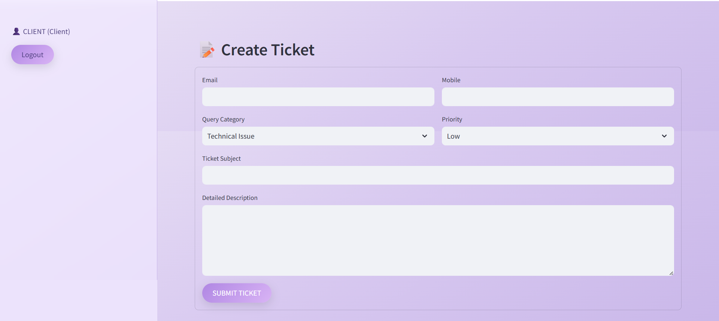
Query Page

Slide 13
Support page​

Slide 14
SUPPORT WORKFLOW & OPERATIONS
CHANNEL 2
TICKET ANALYSIS
CHANNEL 4
TICKET CLOSURE
Issue analysis
Ticket closure
Assigned Ticket
Analysis
Solution
Closure
CHANNEL 3
ISSUE SOLUTION
CHANNEL 1
TICKET INTAKE
Solution & updates
Assigned ticket received

Slide 15
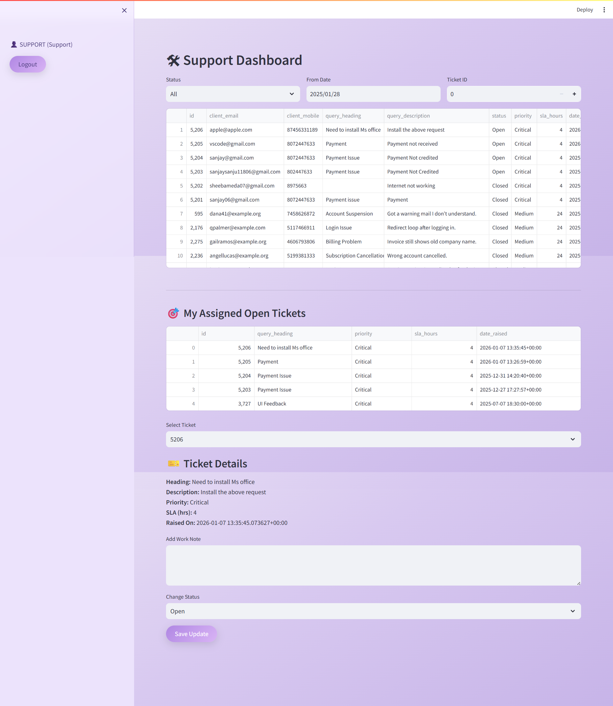
Support Page

Slide 16
Admin page​

Slide 17
ADMIN RESPONSIBILITIES & USER MANAGEMENT
TICKET ASSIGNMENT
User Management
SYSTEM MONITORING
REPORTING & ANALYTICS
DATA MANAGEMENT
ACCESS CONTROL
Assigns tickets to support teams with priority and SLA
Manages user accounts and roles for clients and support staff.
Monitors overall ticket status and system activity.
Maintains centralized query data and system integrity
Reviews ticket trends, resolution rates, and performance metrics.
Controls permissions and ensures secure system usage.

Slide 18
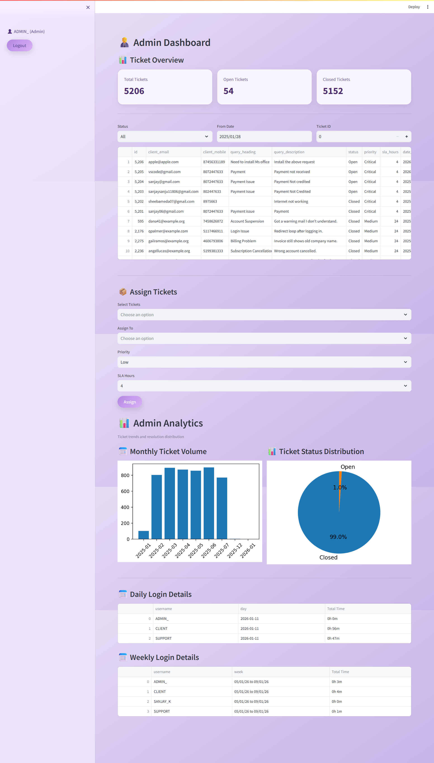
Admin Page

Slide 19

03
Tech Stack

Slide 20
Tech Stack
Frontend (Stream lit): Used to build an interactive web-based user interface for clients, support, and admin dashboards.You can organize your ideas clearly
Backend (Python): Handles application logic, authentication, and ticket processing.
Database (PostgreSQL): Stores user data, queries, ticket status, and activity logs securely.
Libraries (Pandas, Matplotlib, Hashlib): Used for data processing, analytics visualization, and secure password hashing.

Slide 21
THANKS YOU!
THANKS!
Thank you for your time and attention.
Do you have any questions?
This project demonstrates an efficient
Client Query Management System
Project Done By : Sanjay Kannan

